Slide 1

Project Seminar on Web Based Food Order
Presented By
Ms. Raj Nandani
Guided By
Mrs. Roshani Talmale
Department of Computer Science & Engineering
S. B. JAIN INSTITUTE OF TECHNOLOGY MANAGEMENT AND RESEARCH,NAGPUR
An Autonomous Institute, Affiliated to RTMNU, Nagpur

Slide 2
Contents
Problem Statement & Objectives
Introduction
Literature Survey
Flowchart
Use case Diagram
Technology to be Used
Modules
Screenshots
Advantages & Applications
References
2
S. B. Jain Institute of Technology Management and Research

Slide 3
Problem Statement & Objectives
Problem Statement :
As we all knew that due to the pandemic covid-19 it has affected each and every day today activity, it is not easy to go in crowd and order from restaurant itself.
To avoid this, I made a online platform where customers can easily order ahead from their device of their own choice.
Objectives :
To provide an easy access to food from anywhere , anytime.
To Reduce efforts of customer.
To Provide full satisfaction to customers.
3
S. B. Jain Institute of Technology Management and Research

Slide 4
Introduction
Websites are an excellent resource for open source software projects. It should be something where the user wants to visit more. A website provides an ideal opportunity for users to learn more about our project and also users can access websites on a range of devices, including desktops, laptops, tablets, and smartphones.
For this project, I created a website named as Take A Way To Resturant for the food lovers in which I used HTML and CSS programing language. Customers will be able to use the website to order according to their choices. In this website, I created different sections according to the customer’s ease where they can see the menu , can place order & can see all the records.
S. B. Jain Institute of Technology Management and Research
4

Slide 5
Literature Survey
Websites / Paper / Article | Reviews / Findings
www.foodpanda.com
www.munchery.com | offers us the best quality food and beverages at a reasonable price
https://www.takeaway.com | Available for 24 different countries with different name of website leading to online food delivery marketplace.

Slide 6
Flowchart
Start
Sign In
WELCOME
PLACE ORDER
ALL RECORDS
LOGOUT
View Items available with Us
Tea
Coffee
Samosa
Tarri Poha
Select Items
Select Rate
Select Quantity
Total price
Stop
S. B. Jain Institute of Technology Management and research
6

Slide 7

Use case Diagram
Sign in
View Navbar
USER
View Menu
Place Order
Select Items
Select Quantity
View Records
Logout
S. B. Jain Institute of Technology Management and research
7

Slide 8
Technology Used
Front End:
HTML & CSS
IDE:
Visual Studio Code
Hardware:
Laptop
S. B. Jain Institute of Technology Management and research
8

Slide 9
Modules
Login
Welcome
Place Order
All Records
Logout
S. B. Jain Institute of Technology Management and Research
9

Slide 10
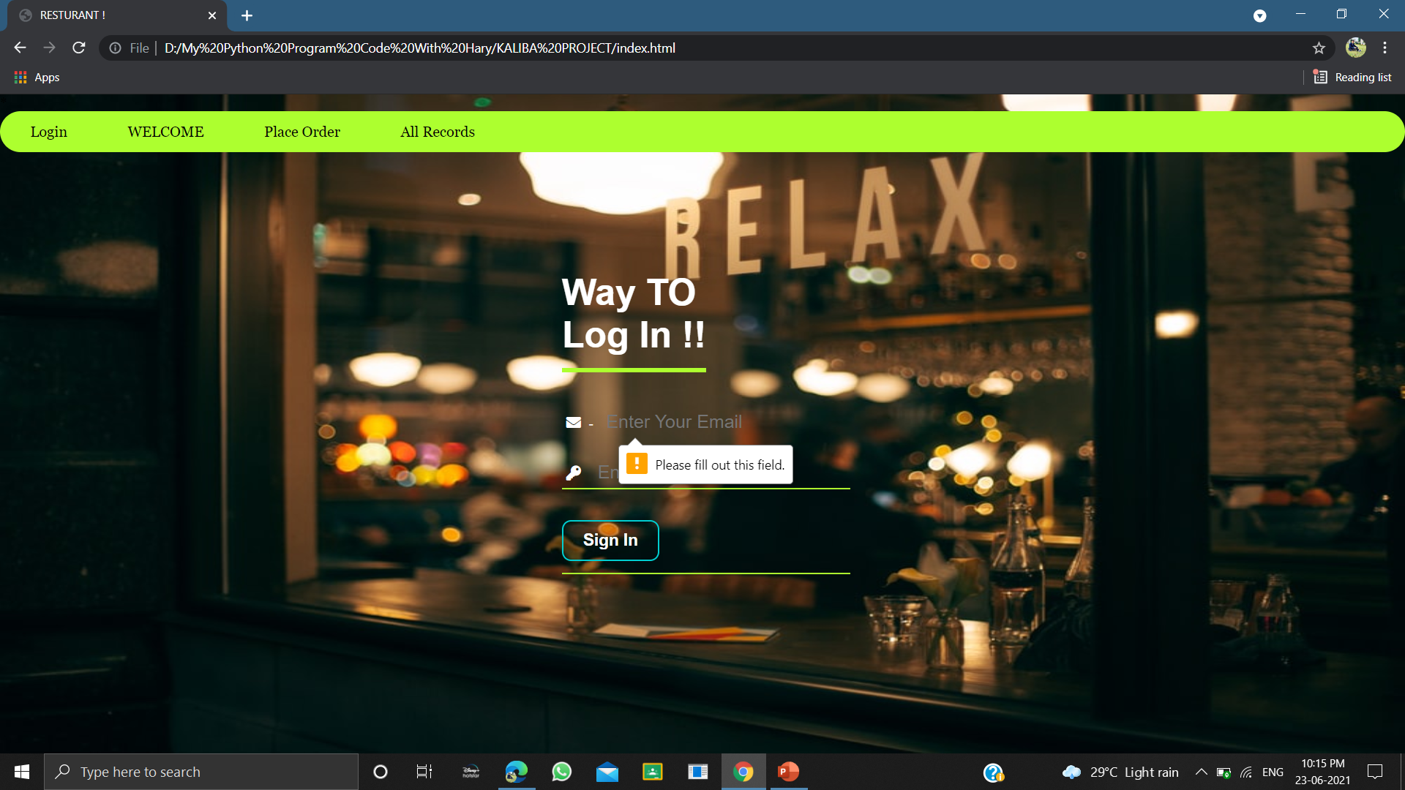
Screen Shots
Login
S. B. Jain Institute of Technology Management and Research
10

Slide 11
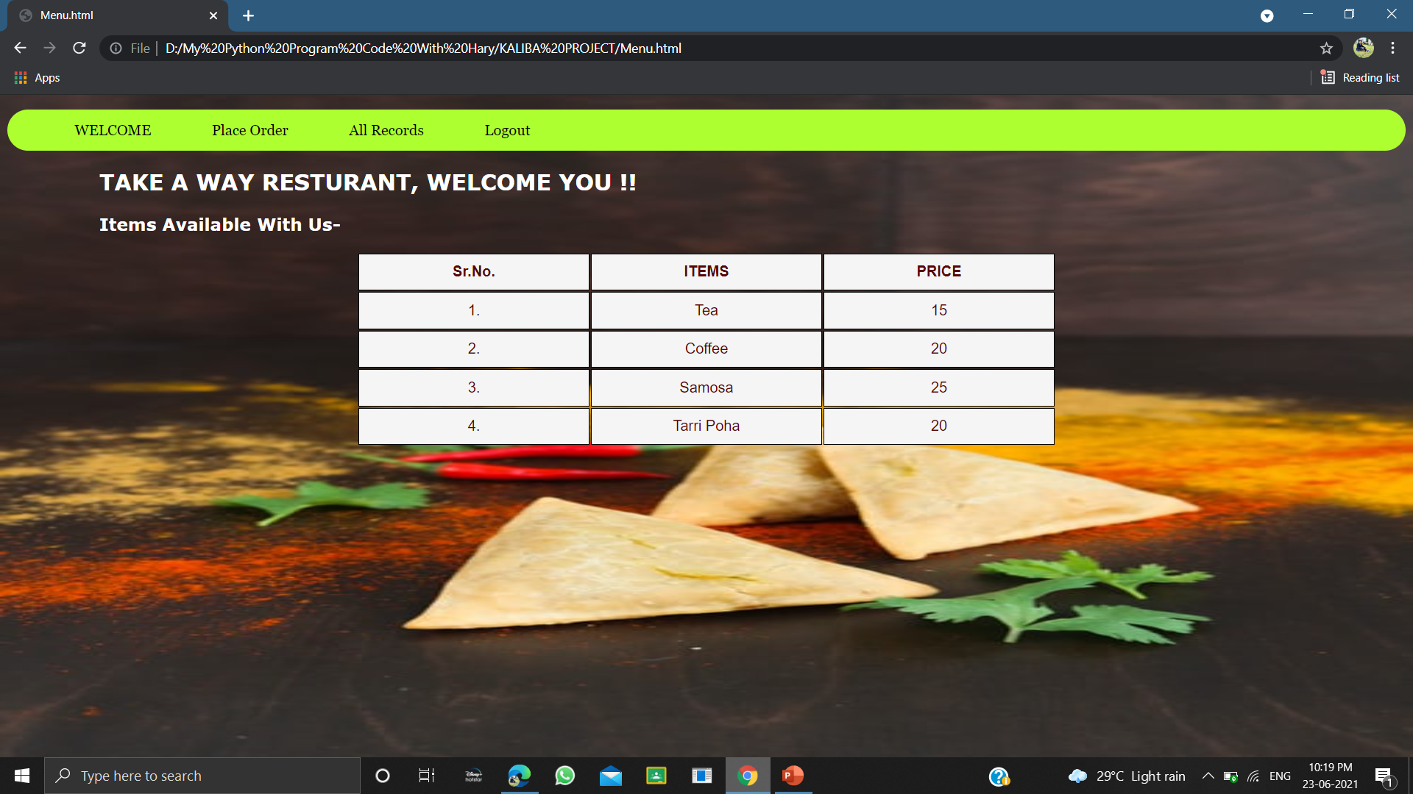
welcome

Slide 12
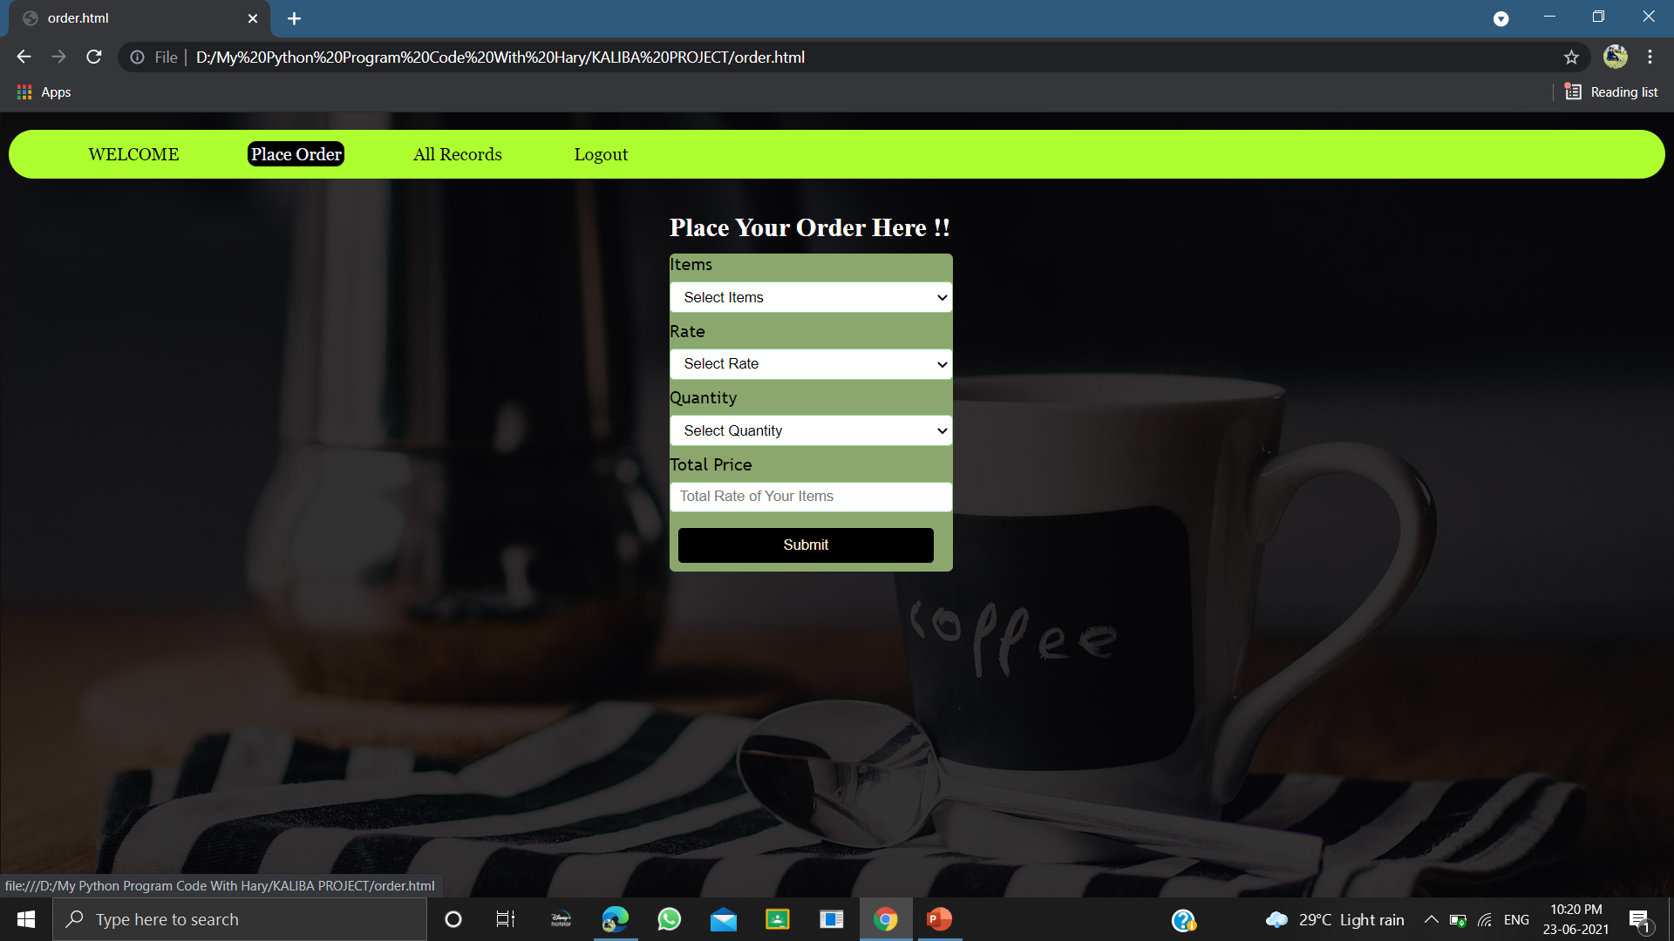
Place Order

Slide 13
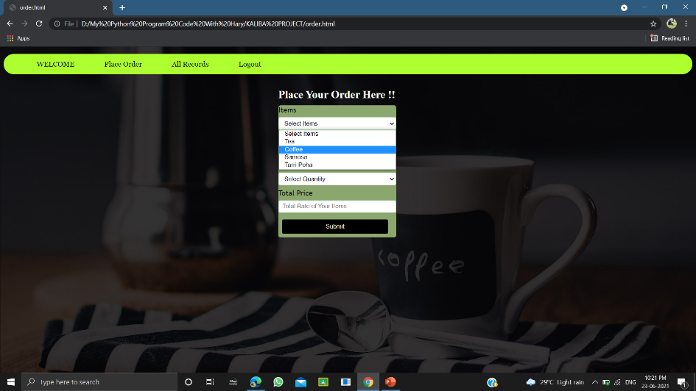
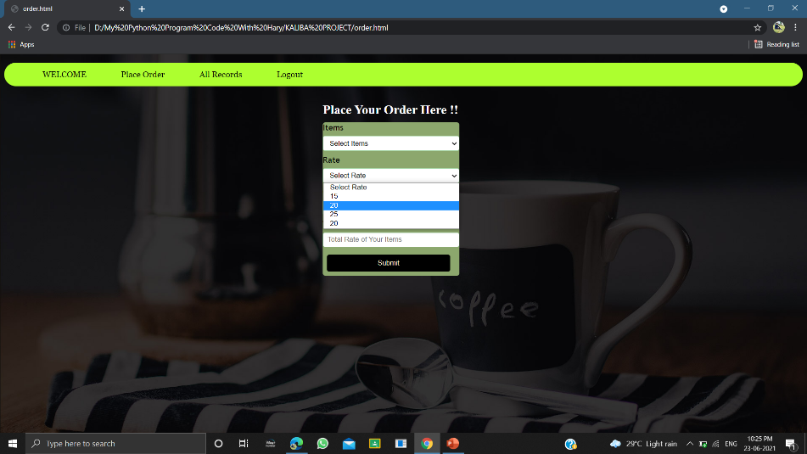
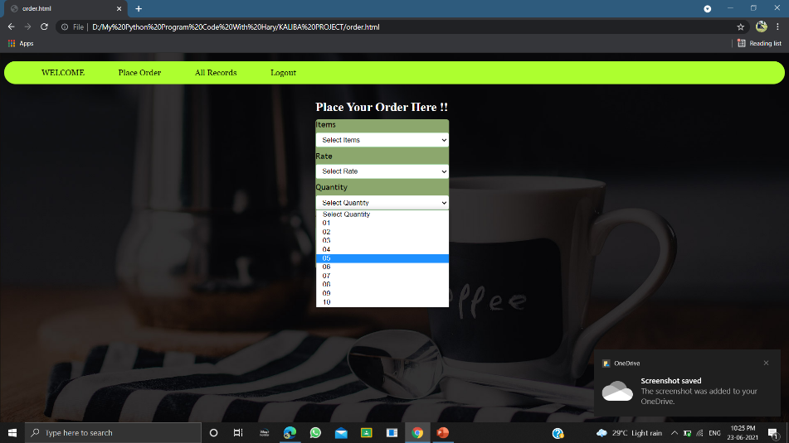
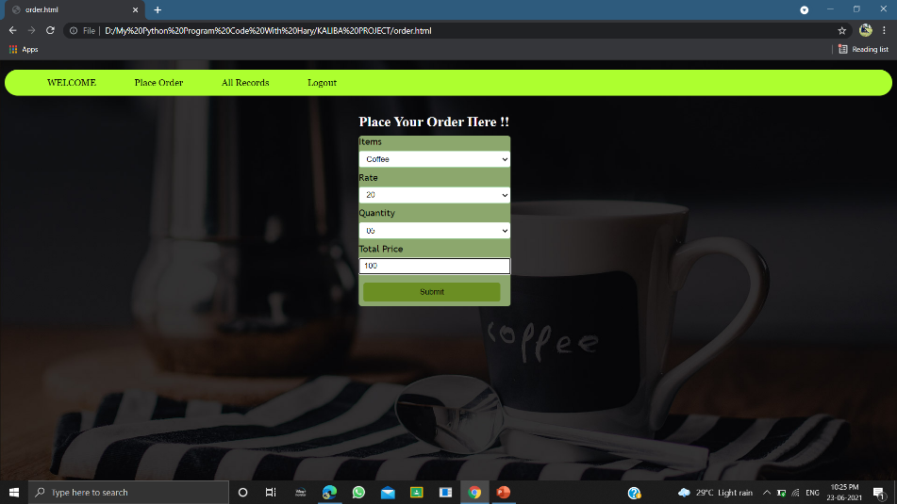

Slide 14
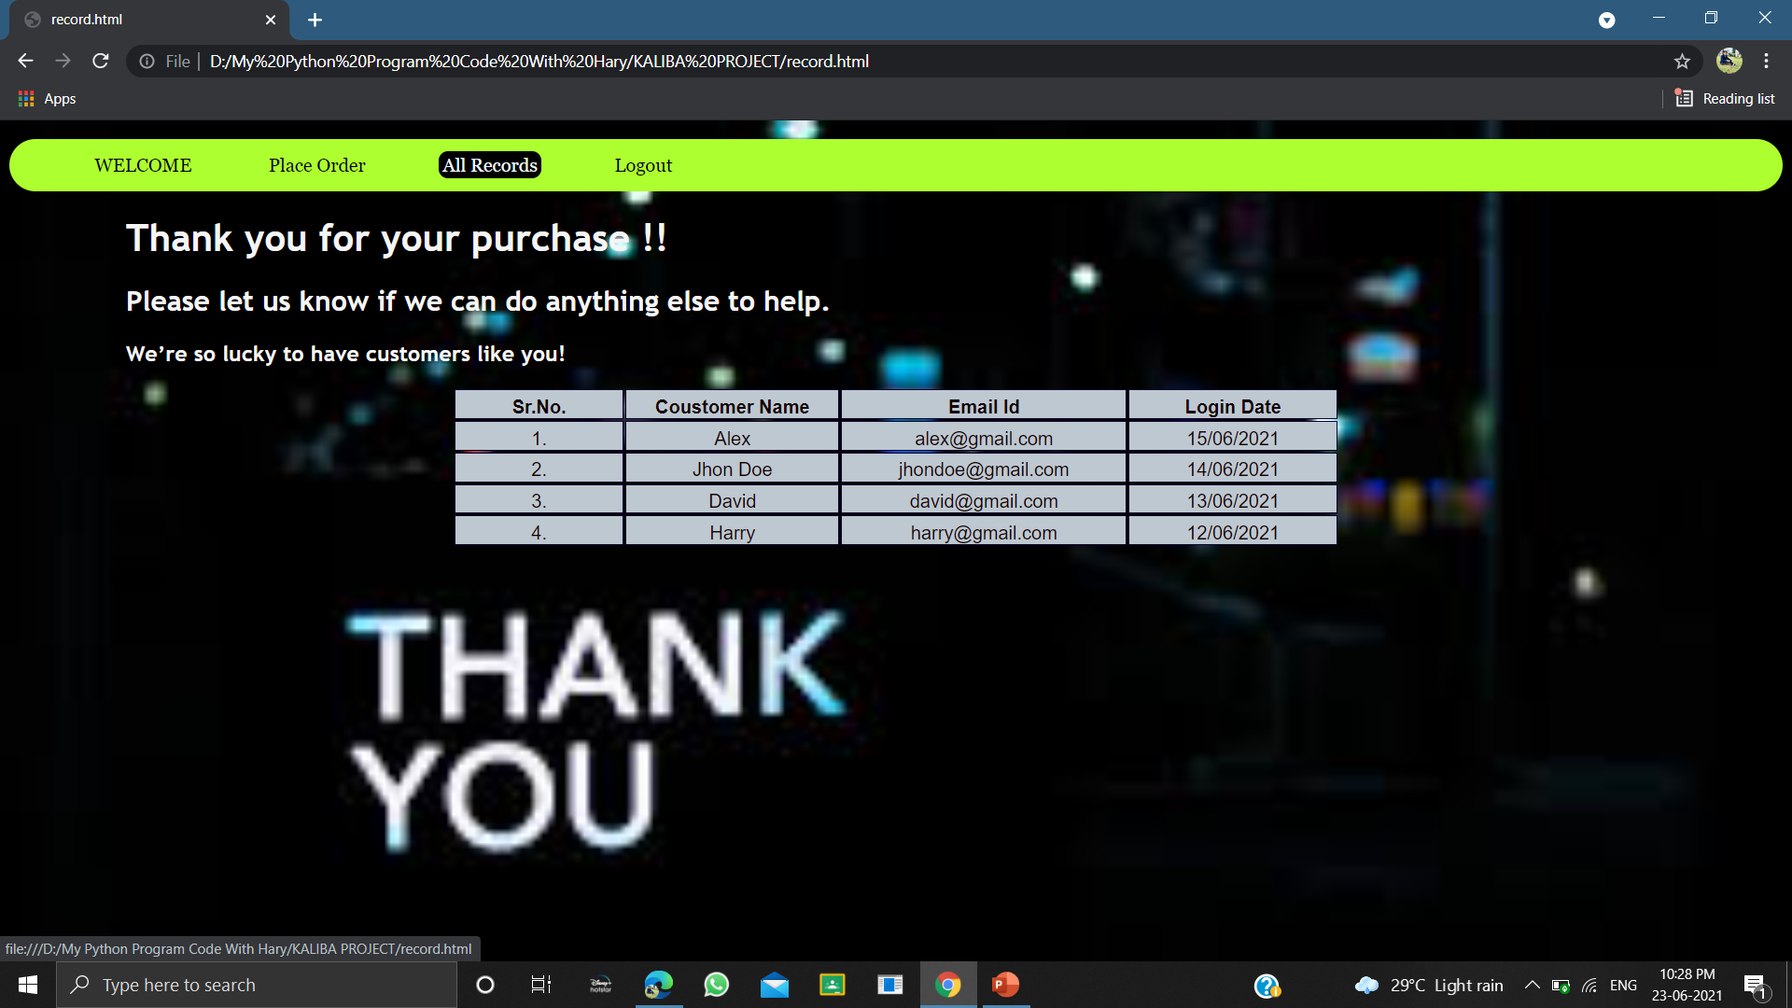
All records

Slide 15
Advantages & Applications
Advantages :-
Accessibility
Variety & Choice
Easier Internal Order
Compatibility
Anyone, Anywhere, Anytime
Applications :-
To allow customers to order ahead from their device of own choice.
S. B. Jain Institute of Technology Management and Research
15

Slide 16
References
Websites:
www.w3schools.com
www.youtube.com
www.w3docs.com
S. B. Jain Institute of Technology Management and Research
16

Slide 17
Thank You

